Slide 1
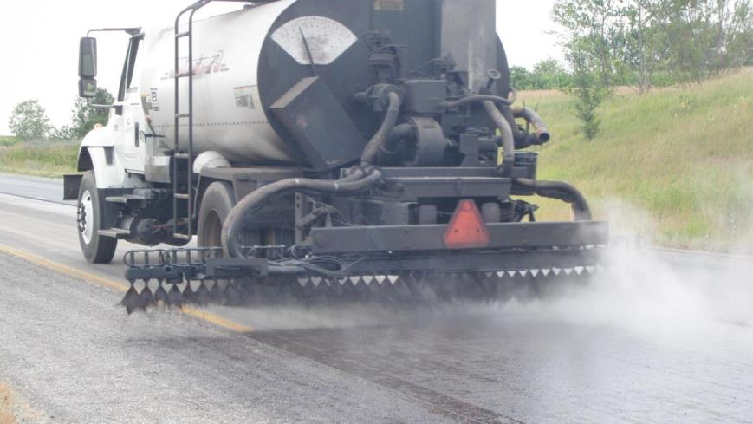

Tack Coat Implementation & Success
Notes:
This is the third of a series of 4-hour workshops that the Asphalt Institute is putting on in cooperation with FHWA. The other two are Longitudinal Joints and Intelligent Compaction. This project is a review of previous and current research combined with best practices and recommendations to achieve well bonded pavement structures. We will show how poorly bonded pavements succumb to early failure and how to avoid those pit falls.

Slide 2

Tack Coat Best Practices
FHWA Cooperative Agreement Subtask
Longitudinal Joints
Intelligent Compaction
Notes:
This is the third of a series of 4-hour workshops that the Asphalt Institute is putting on in cooperation with FHWA. The other two are Longitudinal Joints and Intelligent Compaction. This project is a review of previous and current research combined with best practices and recommendations to achieve well bonded pavement structures. We will show how poorly bonded pavements succumb to early failure and how to avoid those pit falls.

Slide 3
Overall Purpose
… to improve the overall bonding of pavement layers;
to decrease distresses associated with poor bond;
and to improve overall pavement performance.
Notes:
The overall purpose is as defined out here.

Slide 4
Tack Coat Workshops
AK
WA
VT
MT
ME
ND
OR
MN
NH
ID
WI
MA
SD
MI
NY
RI
WY
IA
PA
CT
NJ
DE
MD
DC
NV
NE
OH
UT
IL
IN
CA
CO
WV
KS
MO
VA
KY
TN
NC
AZ
OK
AR
Guam
NM
SC
MS
AL
GA
VI
TX
LA
HI
FL
2014 – Pilot, VA
Completed (35)
Scheduled (10)
Requested (6)
Have not Requested (1)
PR

Slide 5
Notes:
Ask the participants what is happening in the photo, what might be the cause or consequence, what to do if this does happen, and so forth. Let them answer and instructor can fill in the details
Picture from Yellowstone NP of a maintenance overlay being installed by a Park Service crew. Note the lack of tack and how far back the rollers are.

Slide 6
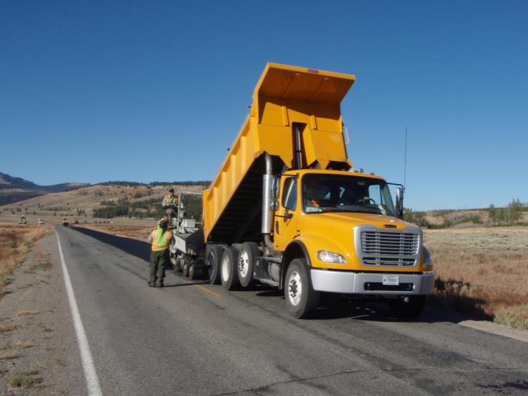

Notes:
Ask the participants what is happening in the photo, what might be the cause or consequence, what to do if this does happen, and so forth. Let them answer and instructor can fill in the details
Picture from Yellowstone NP of a maintenance overlay being installed by a Park Service crew. Note the lack of tack and how far back the rollers are.

Slide 7
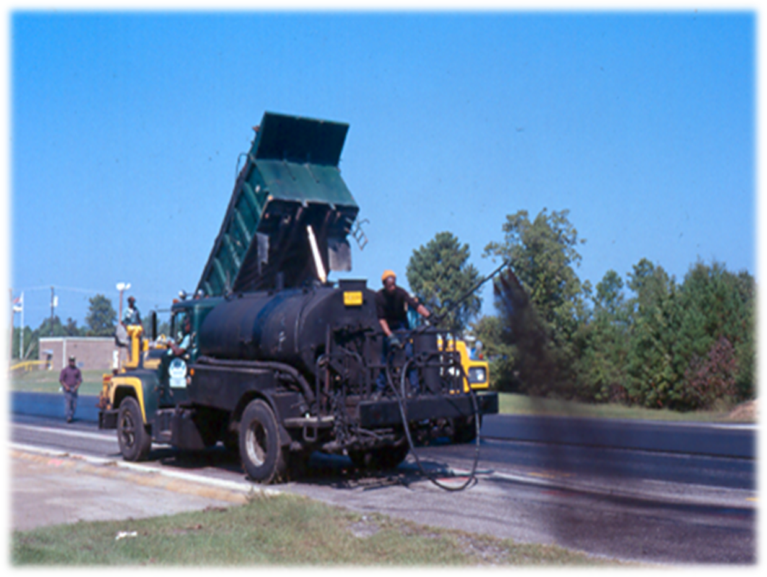
Notes:
The wand on a distributor truck is for small areas that are not readily assessable to the spray bar, not in lieu of the spray bar.

Slide 8
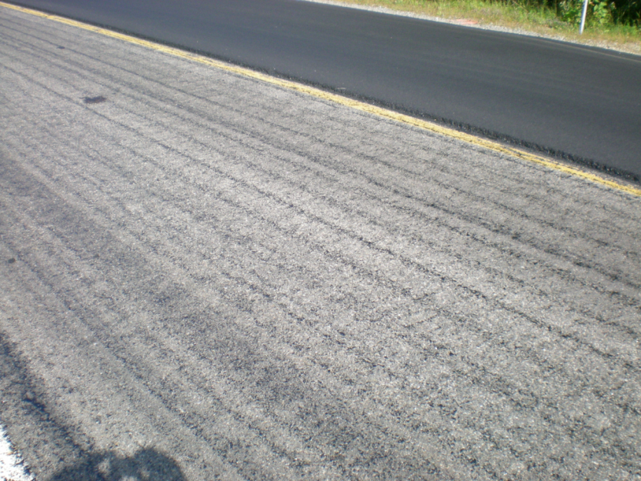
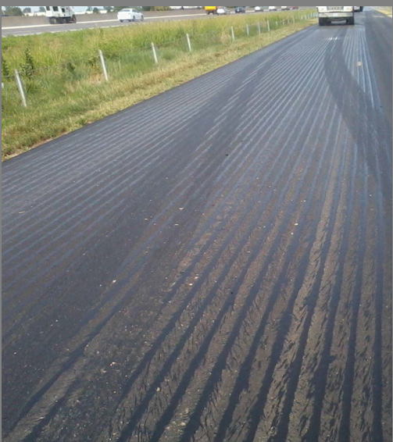
Notes:
Called “zebra tack” by some, applications such as this do not have near the adhesive quality as a uniform spread.

Slide 9
Successful Tack Coat
The Ultimate Goal:
Uniform, complete, and adequate coverage

Slide 10

Importance of Tack Coats
Promote the bond between pavement layers
To prevent slippage between pavement layers
Vital for structural performance
Achieve optimum density
Prevent rutting
Notes:
Let the participant’s list the reasons Tack coats are important. Instructor can fill in the gaps.
The most important purpose is to promote layer bonding. The presenter, NEEDS to emphasize that this is the key reason for tack coats.

Slide 11


Pavement Behavior
Load Distributed by Tire
Shear Transfer
Compression
Stress Distribution
Tension
Aggregate Base
Courtesy of Rich May
Soil Subgrade
Notes:
A well bonded pavement will uniformly distribute stress through the pavement. When all of the layers are bonded and working together, the top half of the pavement will be in Compression with the bottom half of the pavement in Tension, uniformly distributing the load into the base layers. This is the condition assumed when pavements are designed to carry the designated traffic loading. Pavements that are not bonded will not distribute the load as shown above.
Illustration of typical load transfer through a pavement to its base and the subgrade. A bond failure at any of the layers or at multiple layers will alter the idea stress profile, shifting the critical tensile stress from the bottom of the pavement to the bottom of one of the upper lifts. This will dramatically reduce the fatigue life of the pavement.

Slide 12
Loss of Fatigue Life Examples
May & King:
  10% bond loss = 50% less fatigue life
Roffe & Chaignon
  No bond = 60% loss of life
Brown & Brunton
  No Bond = 75% loss of life
  30% bond loss = 70% loss of life
Loss of Life
Notes:
Examples of published research which analyzed the consequences of bond loss and its affect on fatigue life. Simply demonstrates that with even minor losses in bonding, the effect is very significant.
May & King: 2004 TRB presentation
Roffe & Chaignon: (2002) “Characterization Tests on Bond Coats: Worldwide Study, Impact, Tests, Recommendations,” 3rd International Conference on Bituminous Mixtures and Pavements, Thessaloniki, Greece, 2002, pp. 315.
Brown & Brunton: (1984) “The Influence of Bonding Between Bituminous Layers,” The Journal of the Institution of Highways and Transportation, Vol. 31 (5), pp. 361-380.
Slippage cracks are typically localized in nature and relatively inexpensive to repair. Project wide fatigue cracking due to poor pavement layer bonding (or insufficient thickness) can lead to catastrophic loss of pavement. Our review of historical research yielded the estimates shown above. The percentage of lost life referred to is in essence the reduction in pavement life. Unfortunately, for heavily loaded (trafficked) pavements, fatigued pavements are failed pavements that will require very extensive rehabilitation or reconstruction – a 2” overlay or mill and fill may not last if the lower lifts have yielded, do not retain their original strength, or that have also experience bonding failure. So one may ask, does this actually occur in the field.

Slide 13
Consequences of Poor Bonding
Costly pavement repairs
  Repair of isolated area relatively inexpensive
  Removal and replacement of a portion or the entire pavement structure is very expensive
  Shorter than expected performance can be devastating for agency budgets
  Influences future Life Cycle Cost Analysis
Notes:
This slide shows that the consequences of poor bonding is poor pavement performance and costly pavement repairs. Speaker should emphasize that the most costly situation occurs when early fatigue cracking is seen which may require the agency to remove and replace entire layers of pavement sooner than anticipated.

Slide 14
Everyone MUST be on the same page
What we are talking about:
Original Emulsion—an undiluted emulsion which primarily consists of a paving grade binder, water, and an emulsifying agent.
Diluted Emulsion—an emulsion that has been diluted with additional water.
  Critical to control
  1:1 typical (Original Emulsion: Added Water)
Residual Asphalt—the remaining asphalt after an emulsion has set typically 57-70 percent.

Slide 15
What’s wrong (if anything) with the following specification regarding application rate?:
“Apply the tack coat at a rate of 0.05 gallons/yd²”

Slide 16
What difference does it make?
If the example spec intended 0.05 gal/yd² of residual asphalt:
Original emulsion applied at 0.05 gal/yd² using an emulsion with 60% residual asphalt, leaves 0.03 gal/yd² on the roadway?
40% less than intended

Slide 17
What difference does it make?
If the example spec intended 0.05 gal/yd² of residual asphalt:
Diluted Emulsion using the same emulsion diluted 1:1 with water and applied at 0.05 gal/yd² leaves 0.015 gal/yd² on the roadway?
70% less than intended

Slide 18
What difference does it make?
If the example spec intended 0.05 gal/yd² of residual asphalt:
To receive Residual Asphalt at 0.05 gal/yd² using an emulsion with 60% residual asphalt, the contractor would need to apply:
0.083 gal/yd² of Original Emulsion or
0.167 gal/yd² of 1:1 Diluted Emulsion

Slide 19
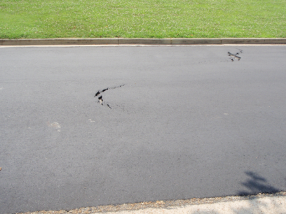
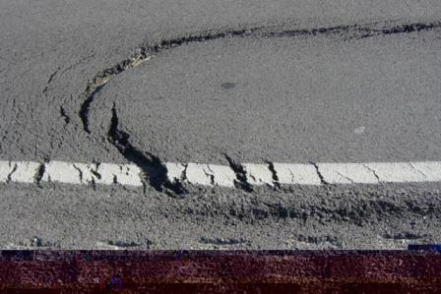
Isolated Slippage Failure
Notes:
Good spot for the instructor to ask what is going on and why, and then he could use that to ‘sell’ how proper tack coat application would have helped in the situation.
Crescent shaped slippage cracks often rapidly appear on poorly or unbonded areas. These slippage cracks typically appear in areas of extreme stress such as braking areas, high speed curves or areas where sharp turning movements occur. This type of cracking is usually limited to local areas of high stress. It is possible for these types of cracks to develop due to excessive tack application, but the typical reason is no or low tack or properly applied tack that has been tracked off the job by mix trucks backing into the paver over uncured tack. A proper mill and patch operation for repairing these areas is necessary to alleviate the distress on a properly designed pavement.
Traffic direction question to students—for both pictures the traffic is from left to right.

Slide 20
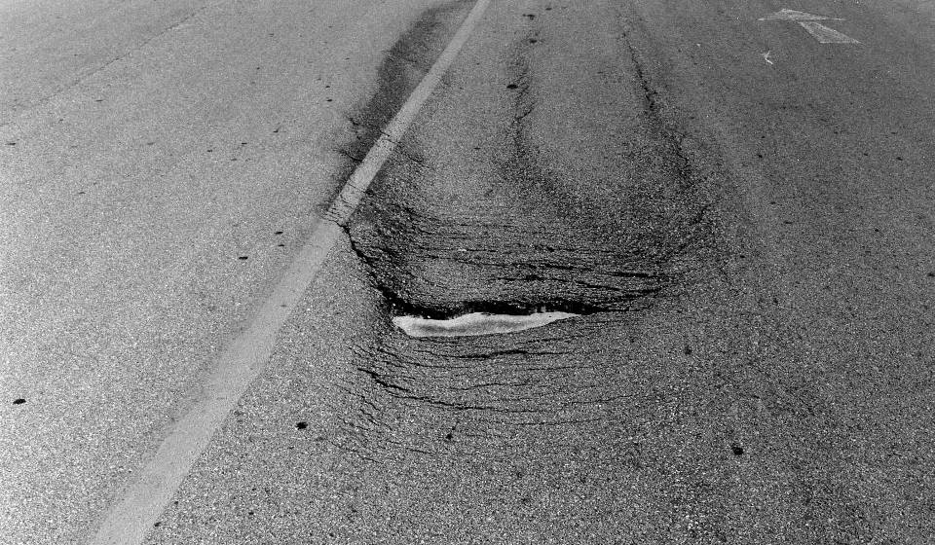
Slippage Failure
Notes:
Slippage Failure
Bond strength wasn’t great enough to resist shear force
Not only the obvious smoothness issue
Also exposing binder course which might be more porous
Allowing water to work at bond and problem will grow
Big whole in the “roof”, shingles are falling off

Slide 21
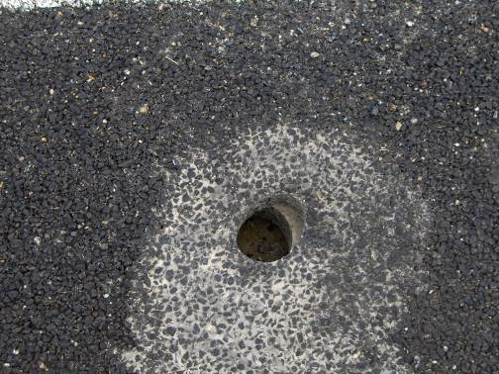
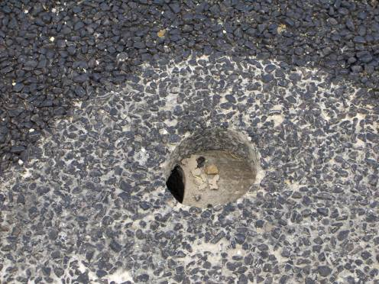
Days later!
Courtesy of Road ScienceTM
Notes:
Dramatic example of layer slippage in the Salt Lake City area.
Yes pavements can move around a lot!!

Slide 22
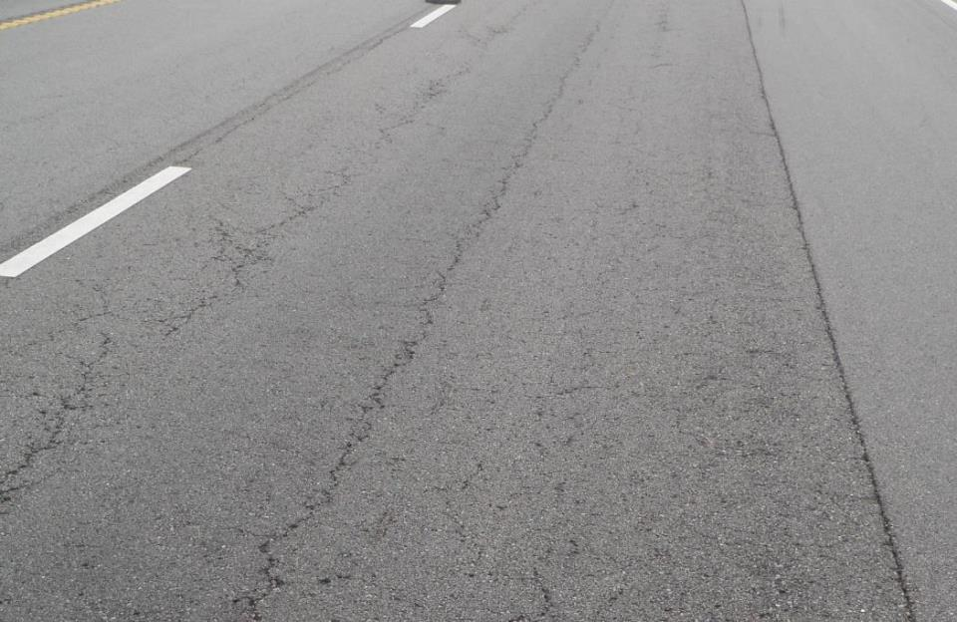
8–10 years est. Interstate Pavement
Courtesy of MoDOT
Notes:
This and the next slide show pictures from a presentation given to the NCAUPG February 2014 meeting by Jason Blomberg, MoDOT. The entire presentation was on why MoDOT was revising their tack coat spec.
Pavement showing fatigue relatively early in its life. Other distresses are seen, but it is the fatigue that has our and their attention as it was determined to relate to poor bonding.

Slide 23
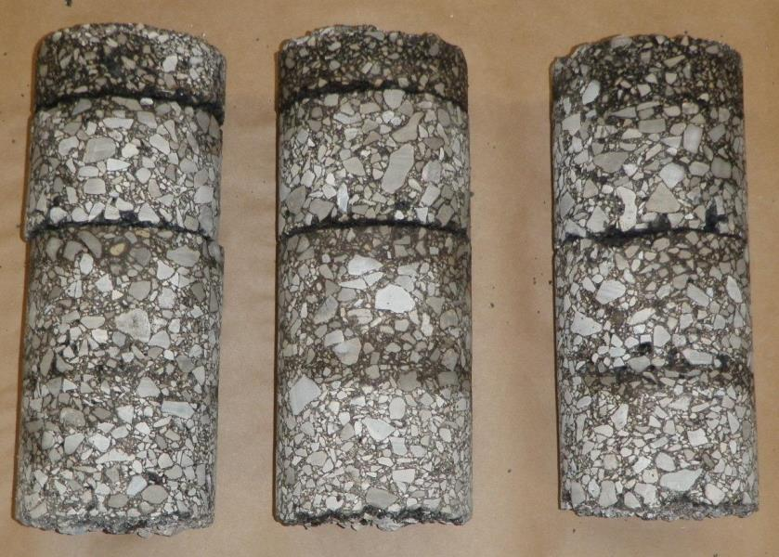
Cores Showing Debonding
Bonding
Failures
Courtesy of MoDOT
Notes:
These are cores from the previously shown pavement.

Slide 24
So is it worth it to apply a tack coat?
Cost of Tack Coat
New or Reconstruction
  About 0.1-0.2% of Project Total
  About 1.0-1.5% of Pavement Total Cost
Mill and Overlay
  About 1.0-2.0% of Project Total
  About 1.0-2.5% of Pavement Total Cost
Notes:
Information as calculated from recent (2013) bid tabs from various states. Intended to emphasize that tack coats are a relatively small part of a project’s overall cost whether it is full-depth construction or a mill and overlay.
So is it worth it to apply a tack – let’s take a look at real world bid tab costs evaluated by AI Engineer Dave Johnson, depending on the type of project, it will vary.
On a major reconstruction or new project many items other than pavement items will be included in the project costs. When looked at from the total project cost – tack is insignificant in cost. It is a larger portion of the pavement cost, but barely a blip on the screen of the overall project bill.
On strictly overlay or mill and fill type projects where pavement makes up the majority of the project cost, the cost of Tack is higher, in the 1-2% range.

Slide 25
Estimated Cost of Bond Failure in the Top Lift
Assume no inflation for materials
Estimated traffic control
Used project plans for thicknesses
Used bid tabs for:
  Milling
  Material costs
  Replaced pavement markings
30-100% of Original
Pavement Costs
Notes:
However, the cost to come back and have to remove and replace lifts due to a bond failure are VERY significant.
This wide range stems primarily from the pavements distress encountered from the lack of bonding. It the distress is localized slippage cracking, spot mill and fill patches may be all that is necessary to return the pavement to a condition that will enable it to achieve its expected lifespan. Extensive project wide fatigue cracking is another story – the early onset of fatigue cracking may require total reconstruction of the pavement. These types of failures, assuming an adequately designed thickness, may last for a few years (5 -15) but the early onset of fatigue cracking will require much more extensive and frequent repair in order for the pavement to reach its expected life. Pavements that suffer extensive fatigue cracking have lost their structural load carrying capacity. “Normal” rehabilitation activities such as a mill and fill will not be effective treatments like they are on well bonded pavement sections.

Slide 26
What is the Risk?
$15,000 Tack Coat Cost
$1M Overlay
$15,000 now or $2 M later?

Slide 27
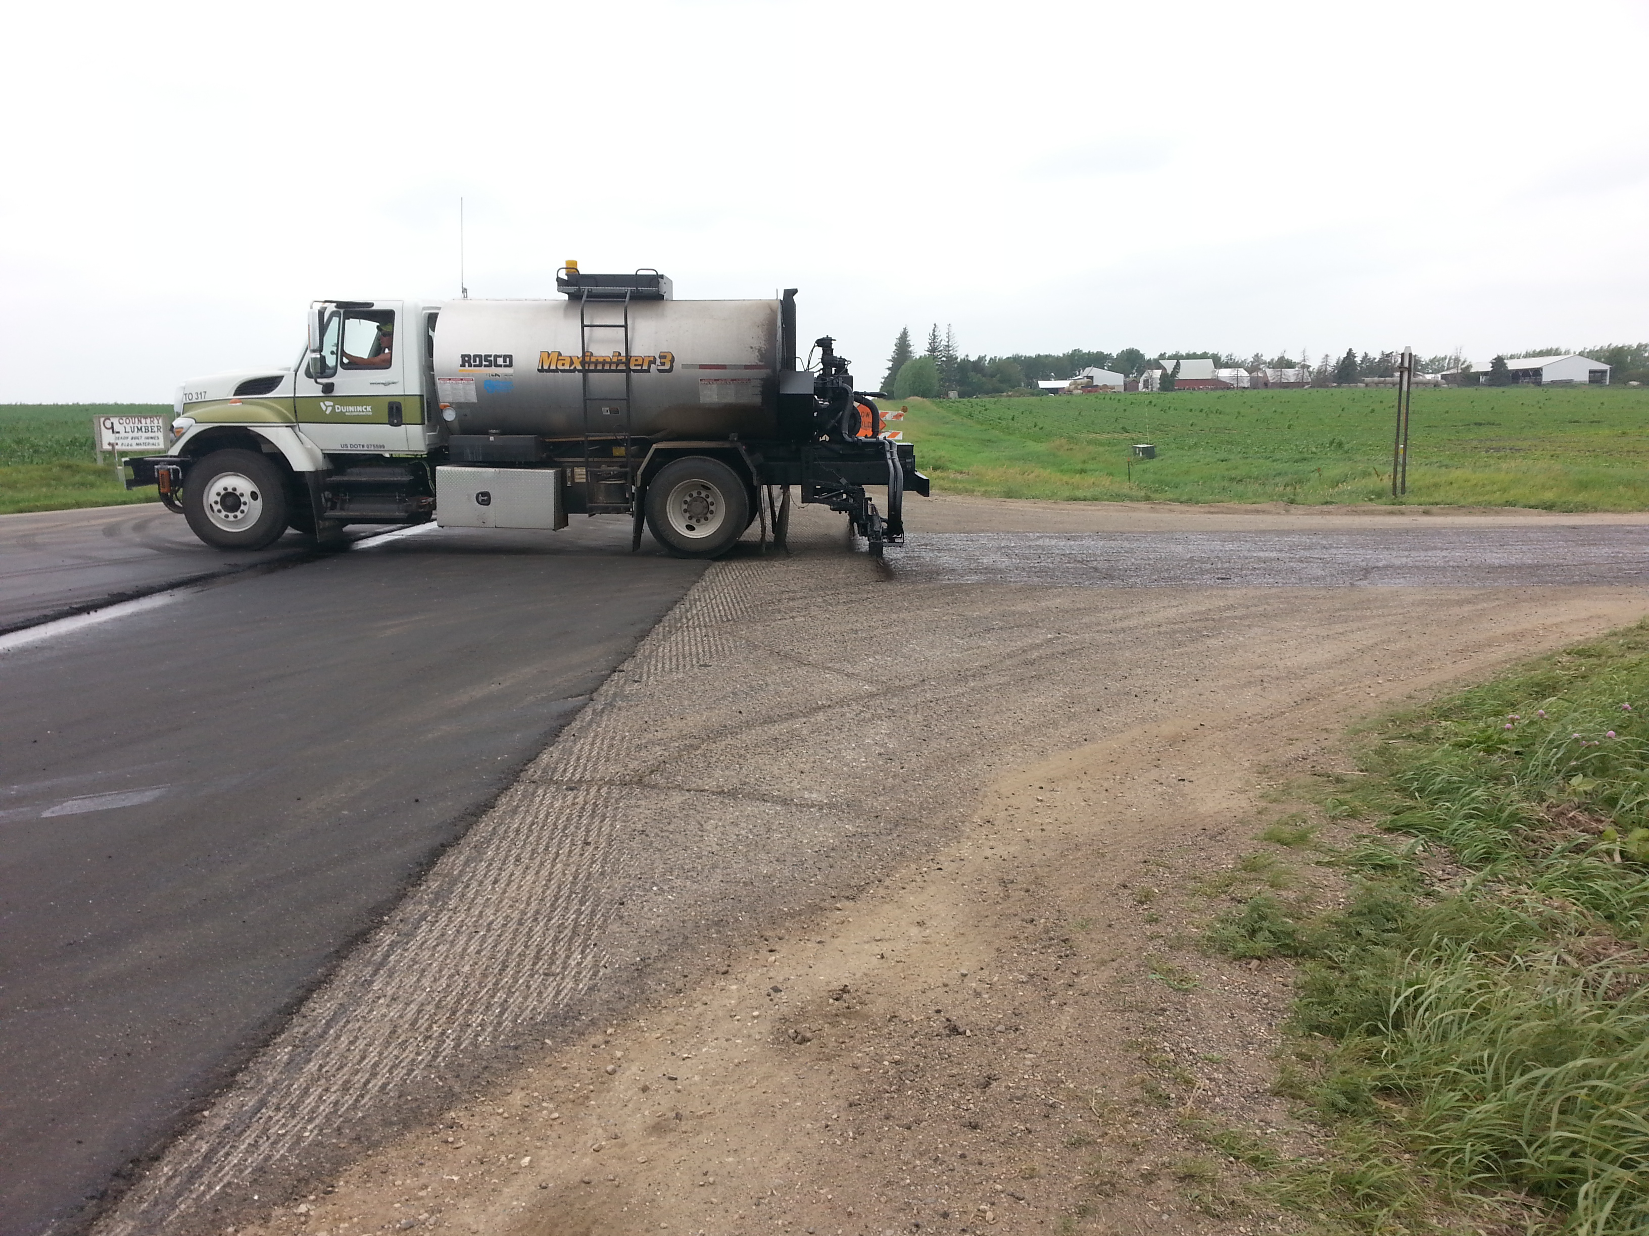
Obstacles In Getting a Good Tack?
Project Pressure due to:
  Working in short construction windows
  Cool, damp weather
  Night time paving
  High traffic areas
  Proper surface cleaning
Notes:
What are the other obstacles are there to getting a good tack and ultimately a good bond and performance?? Working in short construction windows, cold weather, night time paving, in residential areas. Are their solutions to these obstacles?

Slide 28
Current Research
NCHRP 9-40a
SHRP2
Arkansas
Colorado
Illinois
Louisiana
NCAT
Texas
Wisconsin
Oregon
MnRoads
International
Notes:
Bonded layers in flexible pavement is currently a very hot industry topic across the country. Many organizations are researching the best way to optimize layer bonding. Many of them local in nature and how the process fits into their current Quality Management / Inspection systems. Separate or absorbed bid items, QC vs Acceptance monitoring, sampling / testing frequencies, Approved Product list testing to name a few.

Slide 29
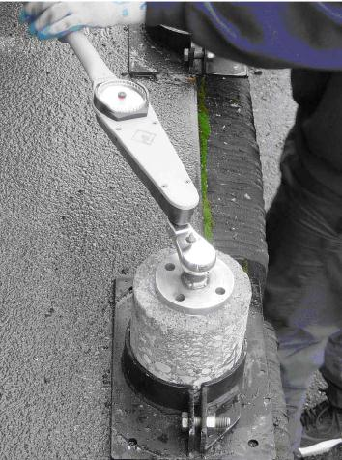
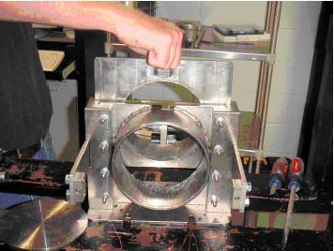
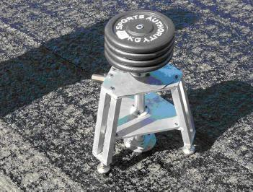
Testing
Field/Laboratory Bond Testing
  Shear Testing
  Torsion Testing
  Pull-Off Testing (tensile)ion)
  Cyclic
Notes:
Test emulsions and PG binders as is typical for a given state.
Bond test discussed in the next few slides.
A major point of consideration underway in some circles is – How do we monitor / specify interlayer bond strength? There are basically two modes to consider, a method spec or a performance spec.
Method Spec – The most customary manor in specifying and monitoring tack application is to specify a material and rate, followed up with on site inspection/monitoring of application rates, dilution rates and uniformity of application. We believe this is a reasonable manor to construct and inspect tack coat application assuming the proper rates and materials are specified. Research has validated that stiffer binder applications tend to produce higher shear strengths in the lab.
Field Bond Testing – We will briefly look at four of the major bond tests being considered for use in evaluating bond strength as shown above. Agencies may wish to consider usage of bond tests in selecting material types, special investigations or as some type of validation test for inclusion into approved products lists, but we do not think that these would need to be required for day to day acceptance testing.

Slide 30
Trends From 35 Workshops
FHWA Best Practices Tech Brief (Dec. 2015)

Slide 31
Trends From 35 Workshops
DOTs Specification Revisions
  Increasing Application Rates
    Spray rates to increase residual rate
  Adjusting application rates for different surfaces
    Fresh asphalt, old asphalt, milled, PCC
  Adding more heat prior to spraying

Slide 32
Trends From 35 Workshops
DOTs Specification Revisions
  Verifying Calibration of Distributors
  Adding more heat prior to spraying
  Eliminating dilution from specifications
    Only when needed and only once by supplier
  Tack as Separate Pay Item vs. Incidental Item
  Moving to Stiffer Base Asphalts
    Improve bonding & reduce tracking

Slide 33
Future Trends
Performance testing as proof of bond strength
  DOT’s will adopt a standardized test
  Monitoring results for a period of time
  Establish a baseline as minimum
  Eventually, contactors will be rewarded or penalized
    Based on test results

Slide 34
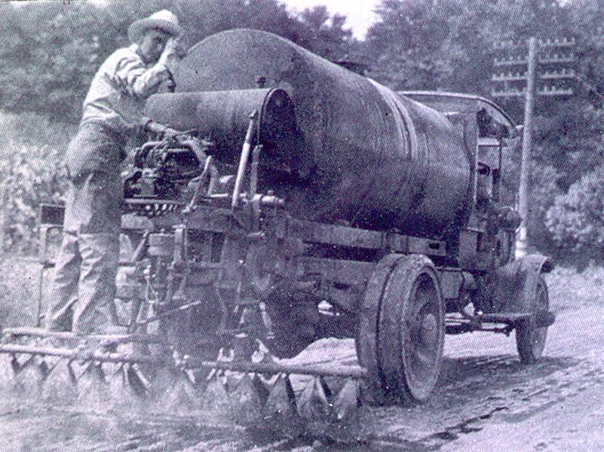

Thank You!
Wayne Jones
Senior Regional Engineer
wjones@asphaltinstitute.org

